Slide 1

Japan Used Car Price Prediction Using Machine Learning
PRESENTED BY: BHUSHAN KHUSHAL NIMJE
GUIDED BY: SAURAV KUMAR

Slide 2
CONTENT: 1. INTRODUCTION 2. DATASET OVERVIEW 3. EXPLORATORY DATA ANALYSIS (EDA) 4. FEATURE ENGINEERING 5. MODEL APPROACH 6. MODEL EVALUATION 7. CONCLUSION

Slide 3
INTRODUCTION
The global rise in used car transactions, particularly in Japan, highlights the need to understand price determinants like brand, model, condition, mileage, and additional features.
This study aims to predict used car prices using a dataset with ten features, including price, brand, model, registration year, mileage, engine capacity, transmission type, drive type, hand drive orientation, and fuel type.
The study employs three machine learning algorithms—linear regression, decision tree regressor, and random forest regressor—to develop predictive models.
By comparing these algorithms, the study seeks to identify the most accurate method for predicting used car prices in a competitive market.

Slide 4
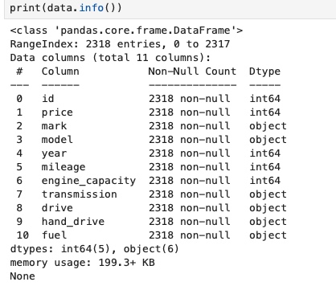
DATASET
The dataset consists of 2,318 rows and 11 columns, providing detailed information on various features of used cars.
The dataset includes ten key features: Price, Brand (Mark), Model, Year, Mileage, Engine Capacity, Transmission Type, Drive Type (2WD, 4WD, AWD), Hand Drive Orientation (Right, Left, Centre), and Fuel Type (Petrol, Diesel, Hybrid, LPG, CNG).
The primary focus of the analysis is on predicting the car's Price based on the other features.

Slide 5
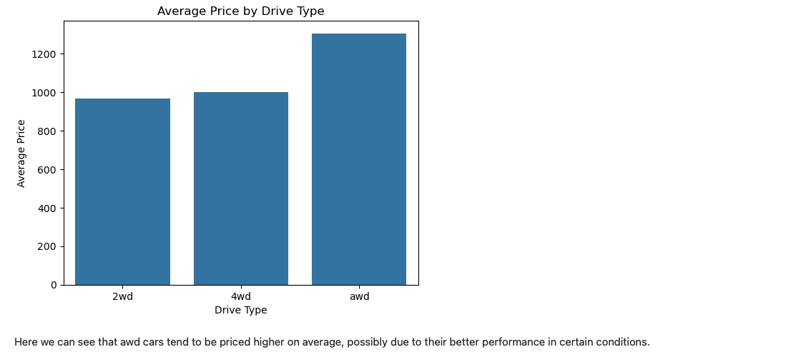
EXPLORATORY DATA ANALYSIS
AWD (All-Wheel Drive) cars tend to be priced higher on average, likely due to superior performance.

Slide 6
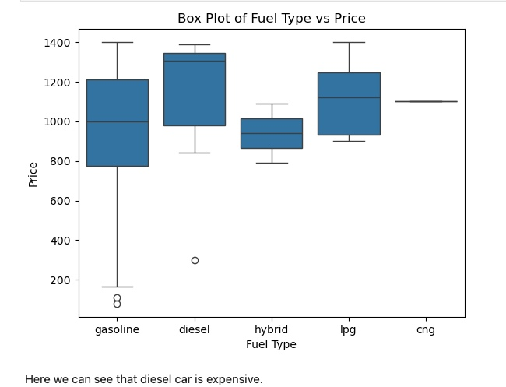
Diesel cars tend to be more expensive compared to other fuel types.

Slide 7
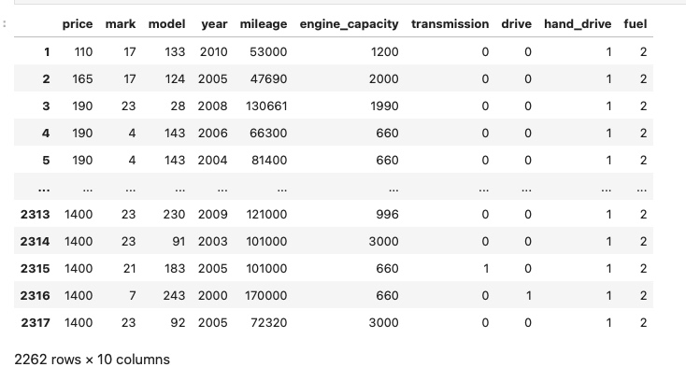
FEATURE ENGINEERING
HANDLING CATEGORICAL VARIABLES:
The dataset contains several categorical features, such as Brand, Model, Transmission, Drive Type, Hand Drive, and Fuel Type. To convert these categorical features into a numerical format that machine learning models can process, we used Label Encoding.

Slide 8
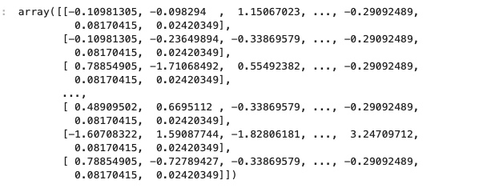
NORMALIZING AND SCALING:
Features in different units or ranges can bias the model's performance, so it’s important to standardize them. We applied Standard Scaling to ensure that all numerical features have a mean of 0 and a standard deviation of 1, which helps the model learn more effectively.

Slide 9
MODEL APPROACH
In this project, we explored three different machine learning algorithms to predict the price of used cars: Linear Regression, Decision Tree Regressor, and Random Forest Regressor. Each algorithm has its unique strengths and is suited to different types of relationships in the data.
To ensure that our models are reliable and can generalize well to unseen data, we split the dataset into training and test sets. The training set is used to fit the models, while the test set is reserved for evaluating their performance. This process helps in selecting the best model and tuning hyperparameters, ultimately leading to more robust predictions.
Linear Regression is a straightforward and interpretable model that assumes a linear relationship between the independent variables (features like mileage, engine capacity, year, etc.) and the dependent variable (price). This model is particularly valuable when you want to understand how much each feature affects the price, as the coefficients directly reflect the impact of each feature.
The Decision Tree Regressor can model non-linear relationships between features and the target variable. Unlike linear regression, it does not assume a linear relationship, making it versatile for capturing complex patterns in the data. Additionally, decision trees can handle both numerical and categorical data naturally, without the need for extensive preprocessing like encoding.
The Random Forest Regressor is an ensemble learning method that builds multiple decision trees and combines their predictions to produce a more accurate and stable result. This approach reduces the risk of overfitting, which single decision trees might suffer from, and improves generalization on unseen data. Random Forest is particularly powerful for handling large datasets with high dimensionality.

Slide 10
MODEL EVALUATION
MAE Comparison: The Random Forest Regressor had the lowest Mean Absolute Error (MAE) of 194.60, indicating the most accurate predictions, while the Linear Regression model had the highest MAE of 217.15.
MSE Comparison: The Random Forest Regressor also had the lowest Mean Squared Error (MSE) at 57,192.57, showing it minimized large errors better than both the Decision Tree Regressor (66,133.58) and Linear Regression (68,058.19).
R² Score: The Random Forest Regressor had the highest R² score of 0.26, suggesting it explained the most variance in the target variable. In contrast, Linear Regression had the lowest R² score of 0.11, indicating the weakest fit.

Slide 11
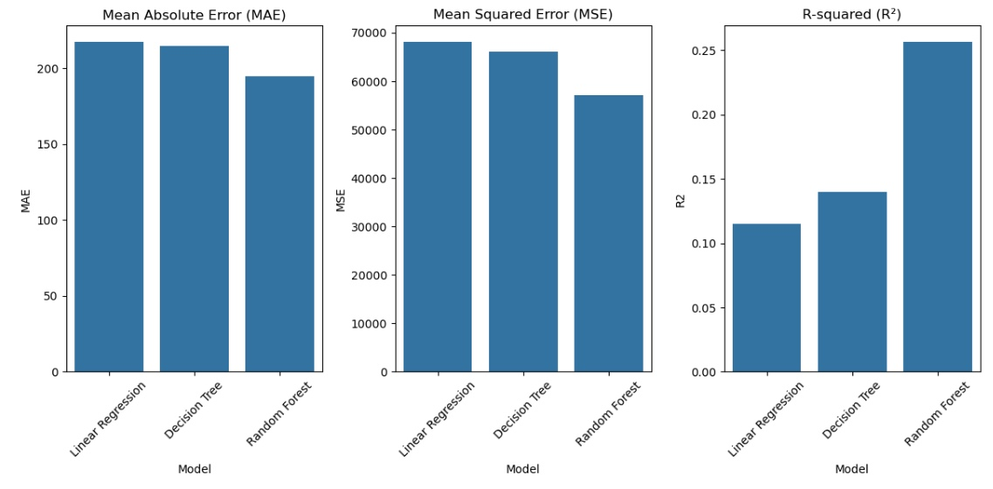
CONCLUSION
The Random Forest Regressor emerged as the best model for predicting used car prices. Its ensemble approach, which combines the predictions of multiple decision trees, allowed it to capture complex relationships in the data, resulting in the most accurate and reliable predictions among the models tested.

Slide 12
THANK YOU

